Slide 1
Understanding the Linux Kernel
Chapter 1
The Introduction

Slide 2
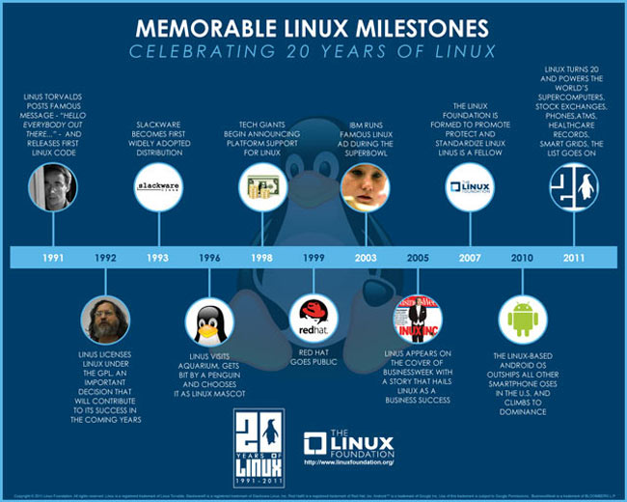

Slide 3
Sections
1.1 – Linux Versus Other Unix-like Kernels
1.2 – Hardware Dependency
1.3 -- Linux Versions
1.4 – Basic Operating System Concepts
1.5 – Overview of the Unix Filesystem
1.6 – Overview of Linux Kernels

Slide 4
A brief history
Linux is a member of the large family of Unix-like operating systems.
Initially developed by Linus Torvalds in 1991 to run on IBM compatible machines.
Linus remains deeply involved with Linux.
Linux has been ported to run on Alphas, Itanium, AMD64, Power PC, zSeries, etc., the list is extensive.

Slide 5
A brief history
Not a traditional commercial operating, it’s source code is under the GNU General Public License (GPL).
It’s open and available for anyone to study.
Latest can be downloaded at http://www.kernel.org
Technically, Linux is a true Unix Kernel, but not a full Unix operating system.
Most programs like desktops and editors, etc, are available under the GPL license.

Slide 6
1.1 Linux Vs. Other Unix-like Kernels
All commercial variants were derived from SVR4 or 4.4BSD
Tend to agree on IEEE’s Portable Operating Systems based on Unix (POSIX) and X/Open’s Common Applications Environment (CAE).
Current Standards specify only an API. No restrictions on internal design.
Share fundamental design ideas and features.
Linux kernel 2.6 aims to comply with POSIX.

Slide 7
Most existing Unix can be compiled and executed on a Linux System.
Includes all of the modern features of Unix Kernels: virtual memory, virtual filesystems, lightweight processes, Unix signals, SVR4 interprocess communication, support for SMP, etc.
Following is a list of how Linux competes with other kernels:
Monolithic Kernel
Compiled and statically linked traditional Unix Kernels (modules)
Kernel Threading
Multithreaded application support
Preemptive kernel
Multiprocessor support
Filesystem
Streams

Slide 8
Designed to freely evolve.
Advantages over competitors:
Cost-free – no cost other than the hardware
Fully customizable in all it’s components
Runs on low-end-inexpensive hardware platforms
Develops are excellent porgrammers
Can be very small and compact
Highly compatible with many common operating systems.
Well supported.
Has in install base on the order of tens of millions of users.

Slide 9
1.2 Hardware Dependency
*Tries* to maintain neat distinction between hardware dependent and hardware-independent source code.
The arch directory in the kernel source tree contains 26 subdirectories to correspond to different hardware platforms
Alpha, arm, avr32, blackfin, cris, frv, h8300, hexagon, ia64, m32r, m68k, microblaze, mips, mn10300, openrisc, parisc, powerpc, s390, score, sh, sparc, tile, um, unicore32, x86, xtensa

Slide 10
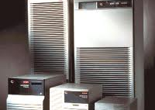
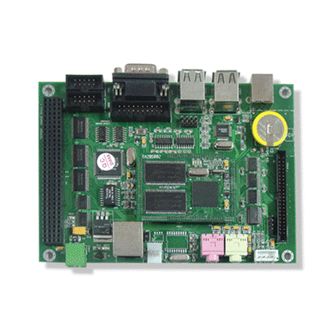
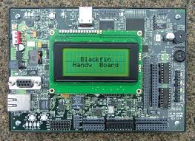
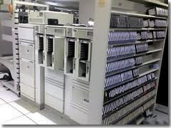
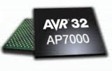
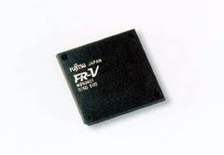
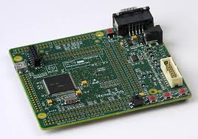
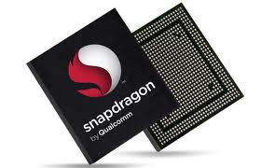
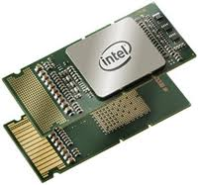
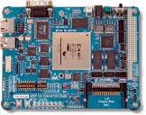
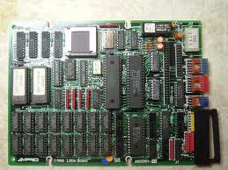
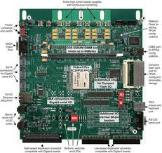
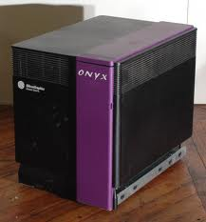
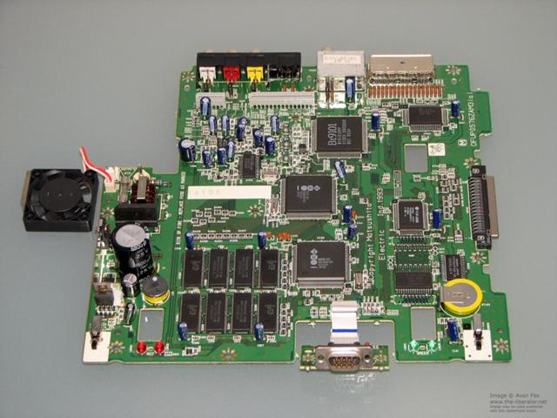
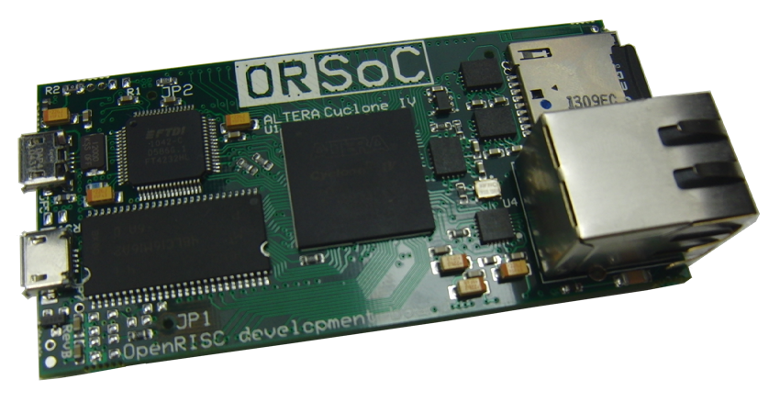
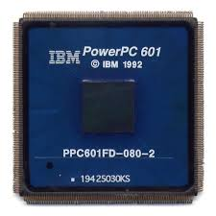
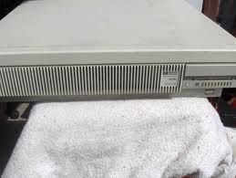
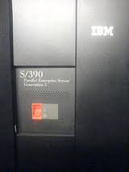
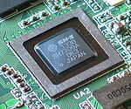
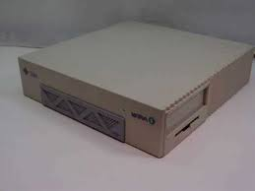
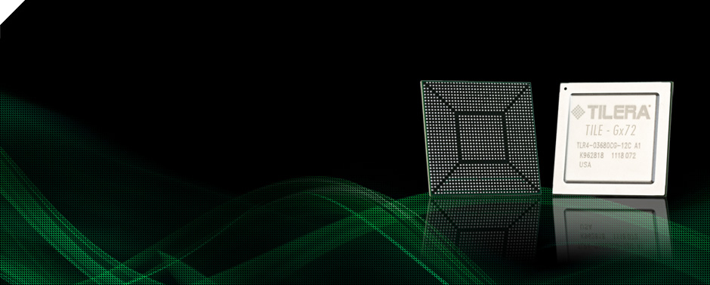
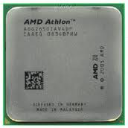
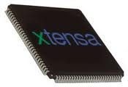

Slide 11
1.3 Linux Versions
Until Kernel 2.5, simple numbering scheme.
1st – version number
2nd – type of kernel (used to be even = stable, odd = development)
3rd – release number
Now – 2nd number refers to large/significant changes.
Current version is 3.12

Slide 12
1.4 Basic Operating System Concepts
Each computer has a basic set of programs called the Operating System (OS).
Provides many of the critical procedures for the system to operate.
Two main objectives:
Interact with hardware components, servicing all low level programmable elements
Provide an execution environment to the applications that run on the system

Slide 13
Unix-like OS hide all low-level details.
When a program wants to use a hardware resource it must issue a request to the OS.
Hardware introduces at least two different execution modes for the CPU:
Nonprivilaged mode for user programs (user mode)
Privileged mode for the kernel (Kernel Mode)

Slide 14
Multiuser Systems
Computer that is able to concurrently and independently execute several application belonging to two or more users.
Must include:
Authentication mechanism for verification of user
Protection mechanism against buggy users programs to could block other applications
Protection mechanism against malicious user programs that could interfere with others
Account mechanism that limits the amount of resource units assigned to each user.

Slide 15
Users and Groups
All users are identified by a unique number – User ID or UID.
Each user is a member of one or more groups identified by the Group ID(s).
Special User call root or superuser.
Enables handling user accounts, system maintenance, backups, so on.
Can do almost anything.
Can access every file on system and manipulate running user programs.

Slide 16
Processes:
Defined as: instance of program in execution - or – execution context.
Traditionally, Executes in single sequence of instructions in an address space – a set of memory addresses that is referenced
Modern day, multiple sequences of instructions executed in the same address space.
Multiuser systems enforce an execution env in which there are concurrent processes and contention for system resources.
Number of CPUs is always restricted, therefore only a finite number of processes can progress at once.

Slide 17
A scheduler chooses which process may progress.
Two types of scheduler:
Nonpreemptable – scheduler only invoked when the process voluntarily releases the CPU.
Preemptable – must be on multiuser system, OS tracks how long a process can hold the CPU and periodically calls the scheduler.
Unix-like OS adopt a process/kernel model
Process makes a system call, hardware changes from User mode to Kernel mode.
Process starts execution of strictly limited kernel procedure.

Slide 18
Kernel Architecture:
Most UNIX kernels are monolithic – each kernel layer is integrated into the the whole kernel.
Linux offers advantages of Microkernels by using modules.
Module: object file who’s code can be linked and unlinked with the kernel during runtime (try that with Windows)!
Code consists of functions for a filesystem, a device, or feature in the kernel’s upper layer.

Slide 19
Main advantages of modules are:
A modularized approach – easy development, can be linked/unlinked during runtime.
Platform independence – doesn’t depend on a fixed hardware platform.
Frugal main memory usage – module can be used only when needed, great for embedded systems
No Performance penalty – once linked, equivalent to the object code of the statically linked kernel.

Slide 20
Overview of the Unix Filesystem
Files:
An information container structured as a sequence of bytes – kernel doesn’t interpret the contents of a file.
Libraries implement higher level abstractions.
Programs in libraries must rely on system calls offered by the kernel.
Files are organized in a tree structured namespace – a directory tree.
All nodes of the tree (where it branches) denote directory names. A node contains information about what is below it.
The root of the tree is call the root directory, it’s name is / (slash).

Slide 21
If a / is used in showing the path to a directory it is an absolute path name.
If the first item is a file or directory it is a relative path.
. = current directory, .. = parent directory
Hard and Soft Links:
Hard link = links a target (file) to a link name (filename) – not possible for directories and can only be on the same file system (can’t cross partitions, etc).
Soft Link = symbolic link – are short files that contain the pathname of another file in any filesystem.

Slide 22
File Types:
Regular Files – text files, shopping list
Directory – node that is part of the filesystem tree
Symbolic Link – see above
Block-oriented device – hard drive
Character-oriented device – keyboard
Pipe and named Pipe (FIFO – first in, first out)
Socket – data passages

Slide 23
File Descriptor and Inode:
All information needed by the filesystem to handle a file is included in a datastructure called an INODE.
Contains the following:
File type
# of hard links associated
File length in bytes
Device ID (identifying the device the info is on)
Inode # that identifies the file within the filesystem
UID of file owner
GID of the file
Timestamps – change time, last access, last modify
Access right and file mode (next section).

Slide 24
Access Rights and File Mode:
Three classes – who owns the file, group who owns the file, and all others.
Three types of access – read, write, execute for each class.
Three additional Flags:
SUID – with this flag, the process gets the UID of the file owner.
SGID – the process gets the GIU of the file owner.
Sticky – requests the kernel to keep the program in memory after its execution terminates.

Slide 25
Opening a File:
Process can access only ‘opened’ files, to open the following happens:
fd = open(path, flag, mode)
Path = where the file is
Flag = how it must be opened – read, write, w/r, append
Mode = access rights of newly created file.
System will return an identifier called a file descriptor.
Will be continued in Chapter 12.

Slide 26
Accessing an Opened File:
Can be accessed randomly or sequentially, kernel store a file pointer
Read(), write() always refer to position of file pointer
Lseek() – requires fd, offset, whence
Read() – requires fd, buff, count (bytes to read)
Closing a file = res = close(fd);
Renaming & Deleting:
Res = rename(oldpath, newpath);
Res = unlink(pathname);

Slide 27
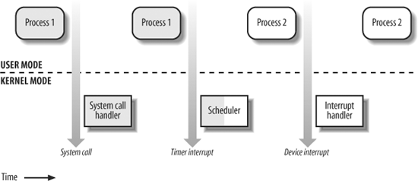
Overview of Unix Kernels
The process/kernel model:
Kernels do much more than handle system calls, kernel routines can be activated by:
A process invokes a system call
CPU sends an interrupt (invalid instruction)
A peripheral device issues an interrupt.
A kernel thread is executed.

